Slide 1

Data Structures Project
-- Text Editor --
BY: Sanjay .T && Saravanan.R
(19PW28) && (19PW31)

Slide 2
A text editor using c++ with possible Data structures
01
02
03
04
05
06
Ternary
search tree
Gap buffer
Data structure
Trie
Data structure
Linked list
Data structure
Queue
Data structure
Stack
Data structure
To check for grammatical errors
To move the cursor And make insertion effective
To enable autocomplete feature
To edit the text after creating a file
Input processing
Undo-Redo

Slide 3
01
Ternary Search Tree
To check grammatical error

Slide 4
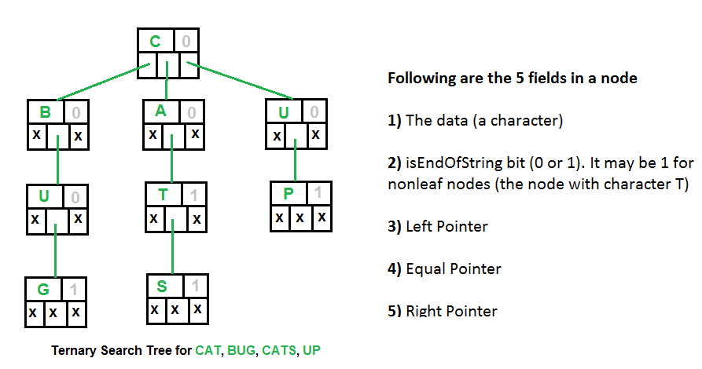
Ternary Search Tree
Usage
We insert 20000 frequently used english words into the tree
And the input given by user is stored in a queue and each word is examined with the words present in the tree so if any error can be detected easily

Slide 5
02
Gap buffer
For effective insertion in the words

Slide 6
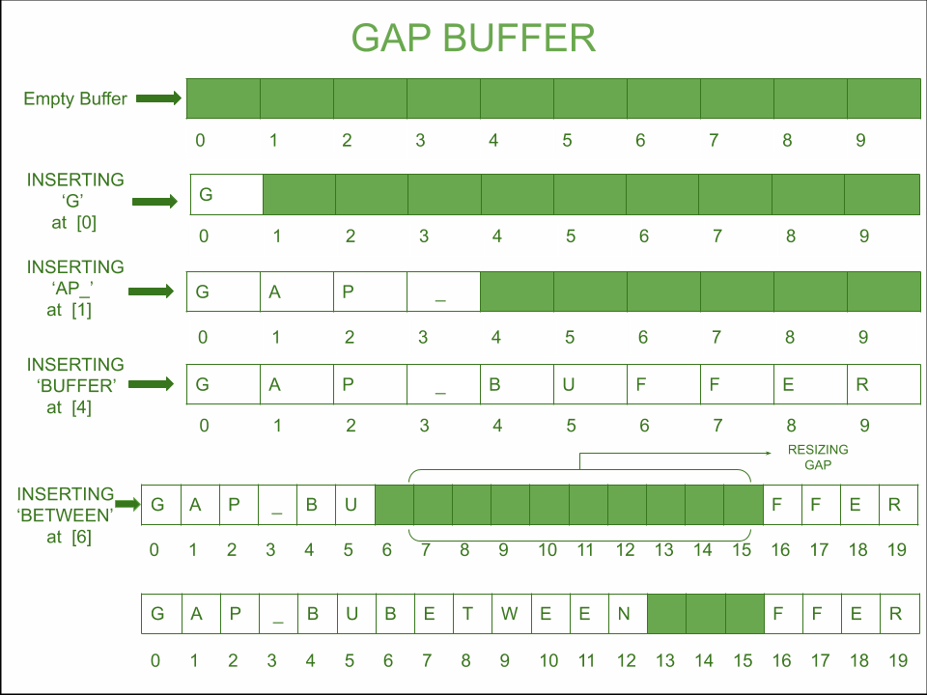
Gap Buffer Data structure
Usage
We used gap buffer data structure to make an effective insertion between words in o(1) complexity
It is more effective than rope data structure.The cursor can be moved using the gap.

Slide 7
03
Trie
For Autocomplete feature in the text editor

Slide 8
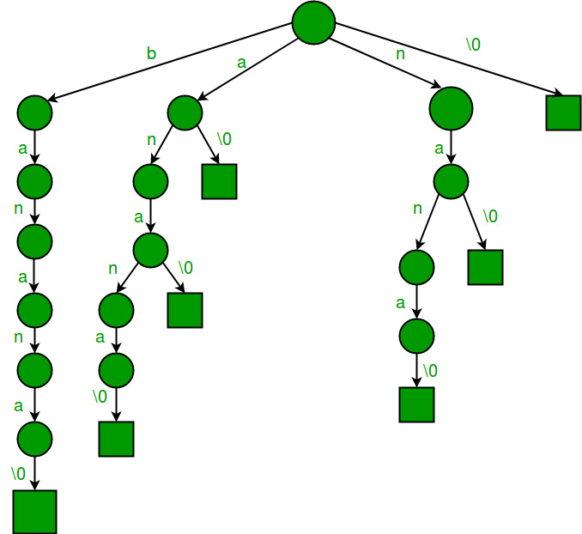
Trie Data structures
Usage
It can be used in autocomplete feature but in c++ editors once displayed the cursor cannot be made to move to the top so we used to display the list of words with the suffix u enter it consist of 40000 words.

Slide 9
04
Linked list
To insert and change the words in a text file

Slide 10
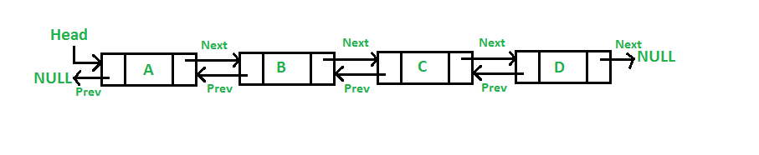
Linked list -Doubly
We used this data structure to store the read words from the file so that we can effectively insert or delete words in the editor by just inserting or deleting nodes then the file can be re-written
Usage

Slide 11
05
Queue
Input processing

Slide 12
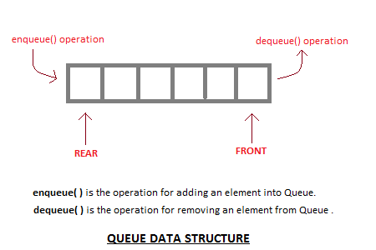
Queue Data structure
Usage
We used this data structure to store the words when user enters in the editor so that we can dequeue
Easily and obtain the sentence in order to check for grammatical errors with ternary search tree.

Slide 13
06
stack
undo-redo

Slide 14
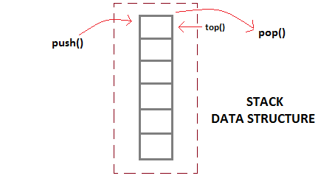
Stack Data structure
Usage
We used stack to perform undo redo operation we can even perform cut copy paste using stack as it involves last in first out

Slide 15
Text editor
Data structures with output screen
Explanation

Slide 16
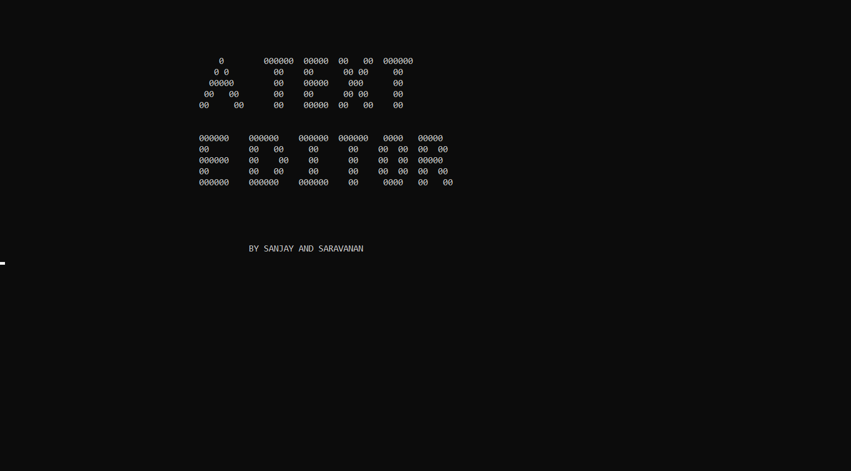
Welcome to our Text editor

Slide 17
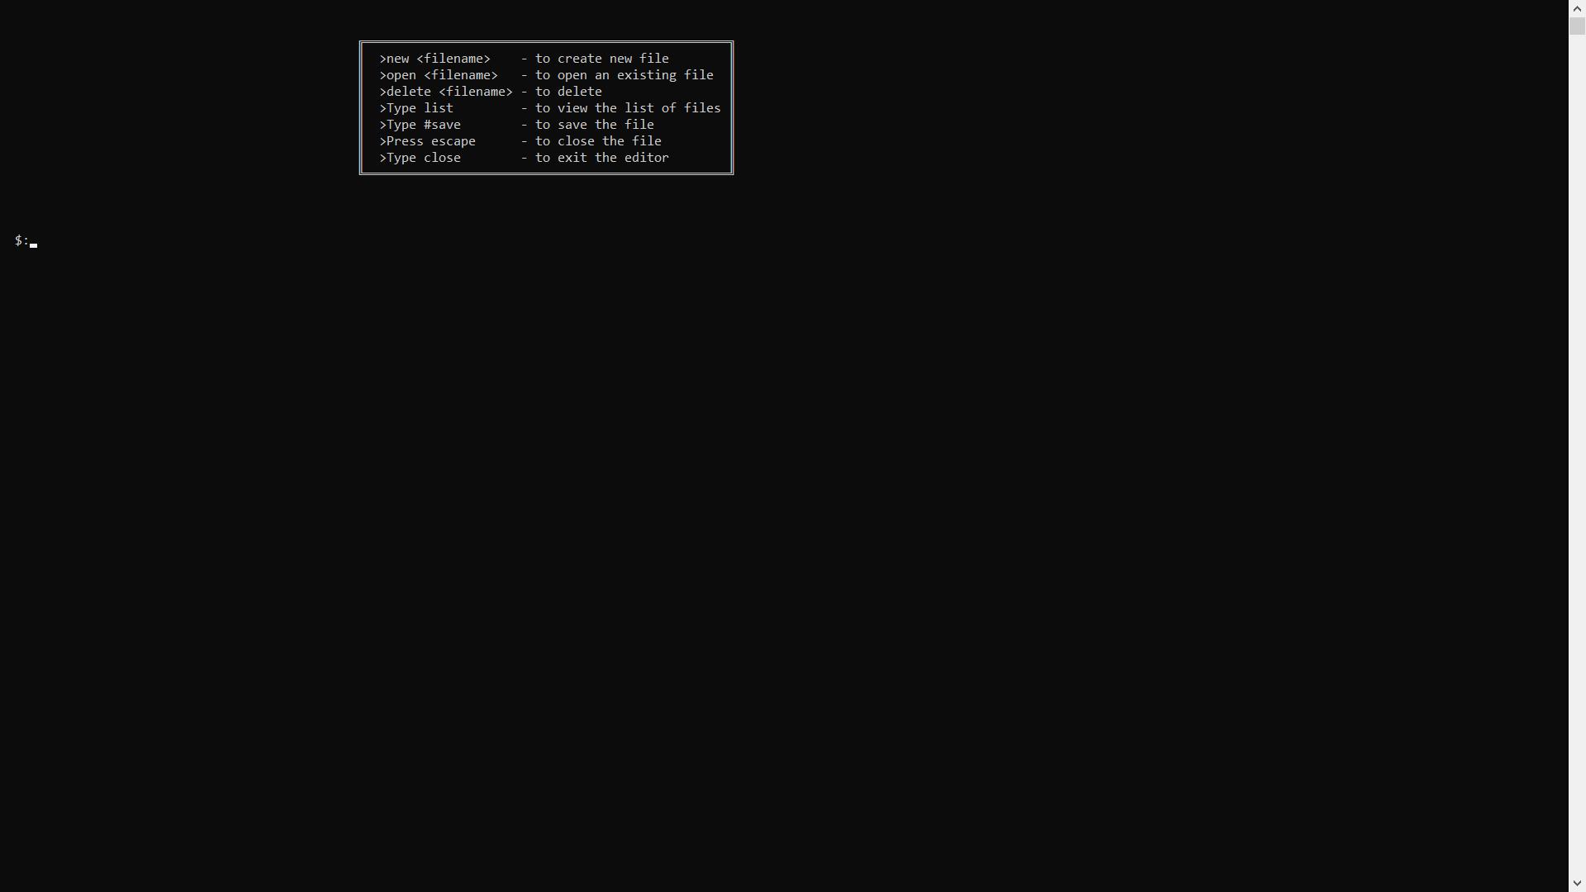
Starting page

Slide 18
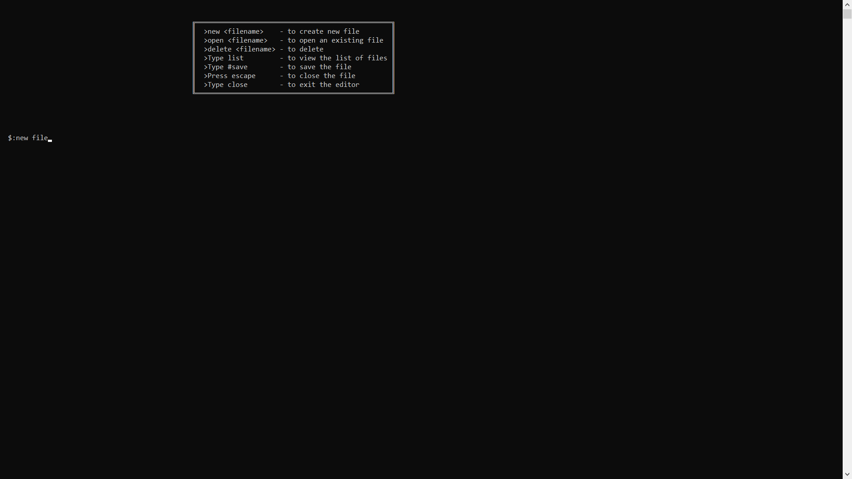
Type ” new <filename of your wish> “ to create a document

Slide 19
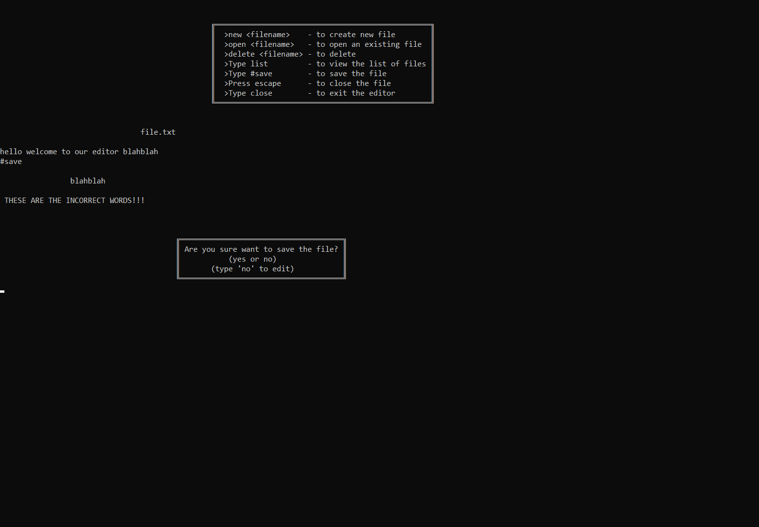
Type the text when type #save it will be saved
Explanation
Usage of ternary search
Tree and queue
When we type the words they are first inserted into the queue
And each word is searched in the tree .We have inserted english words in ternary search tree so that if you type any error words it will be searched in the tree and if not present will send you an error message then when u click yes file is saved if no recreate the file

Slide 20
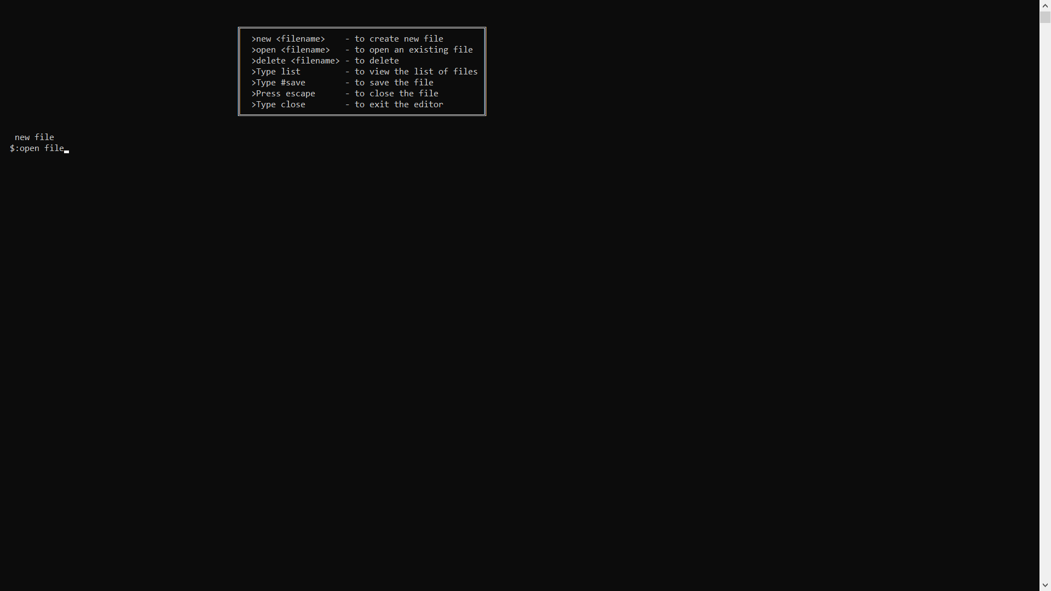
Type “ open <filename that u want to open>” to open

Slide 21
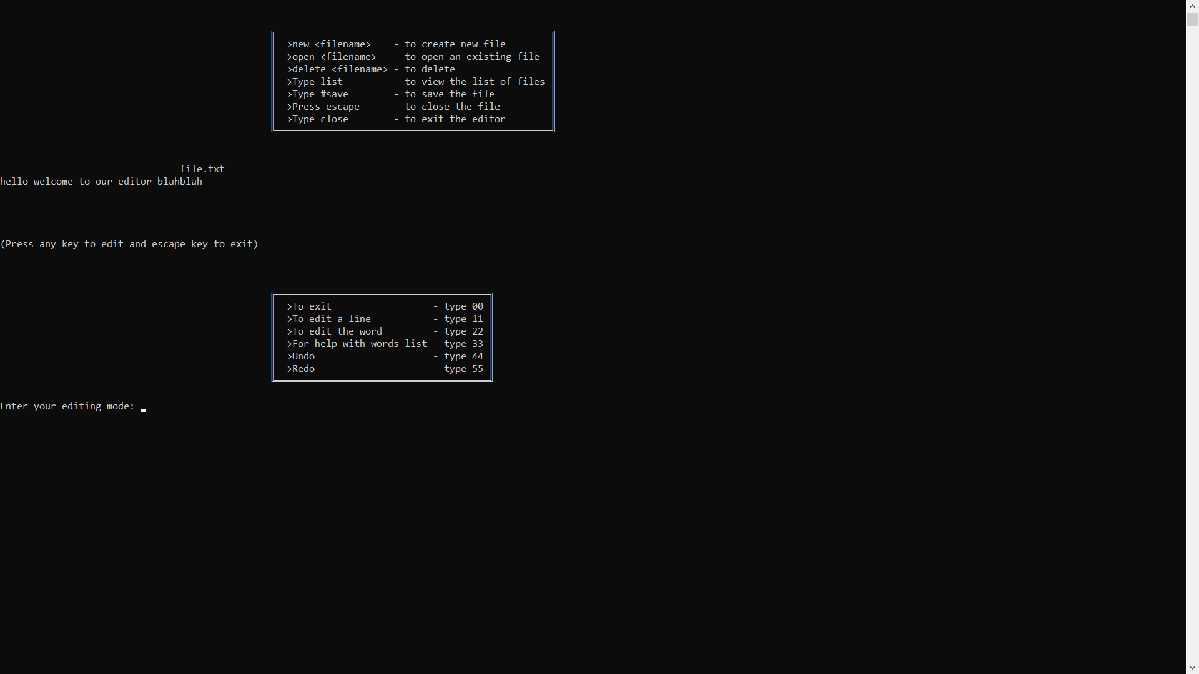
After which you can edit as given in the box

Slide 22
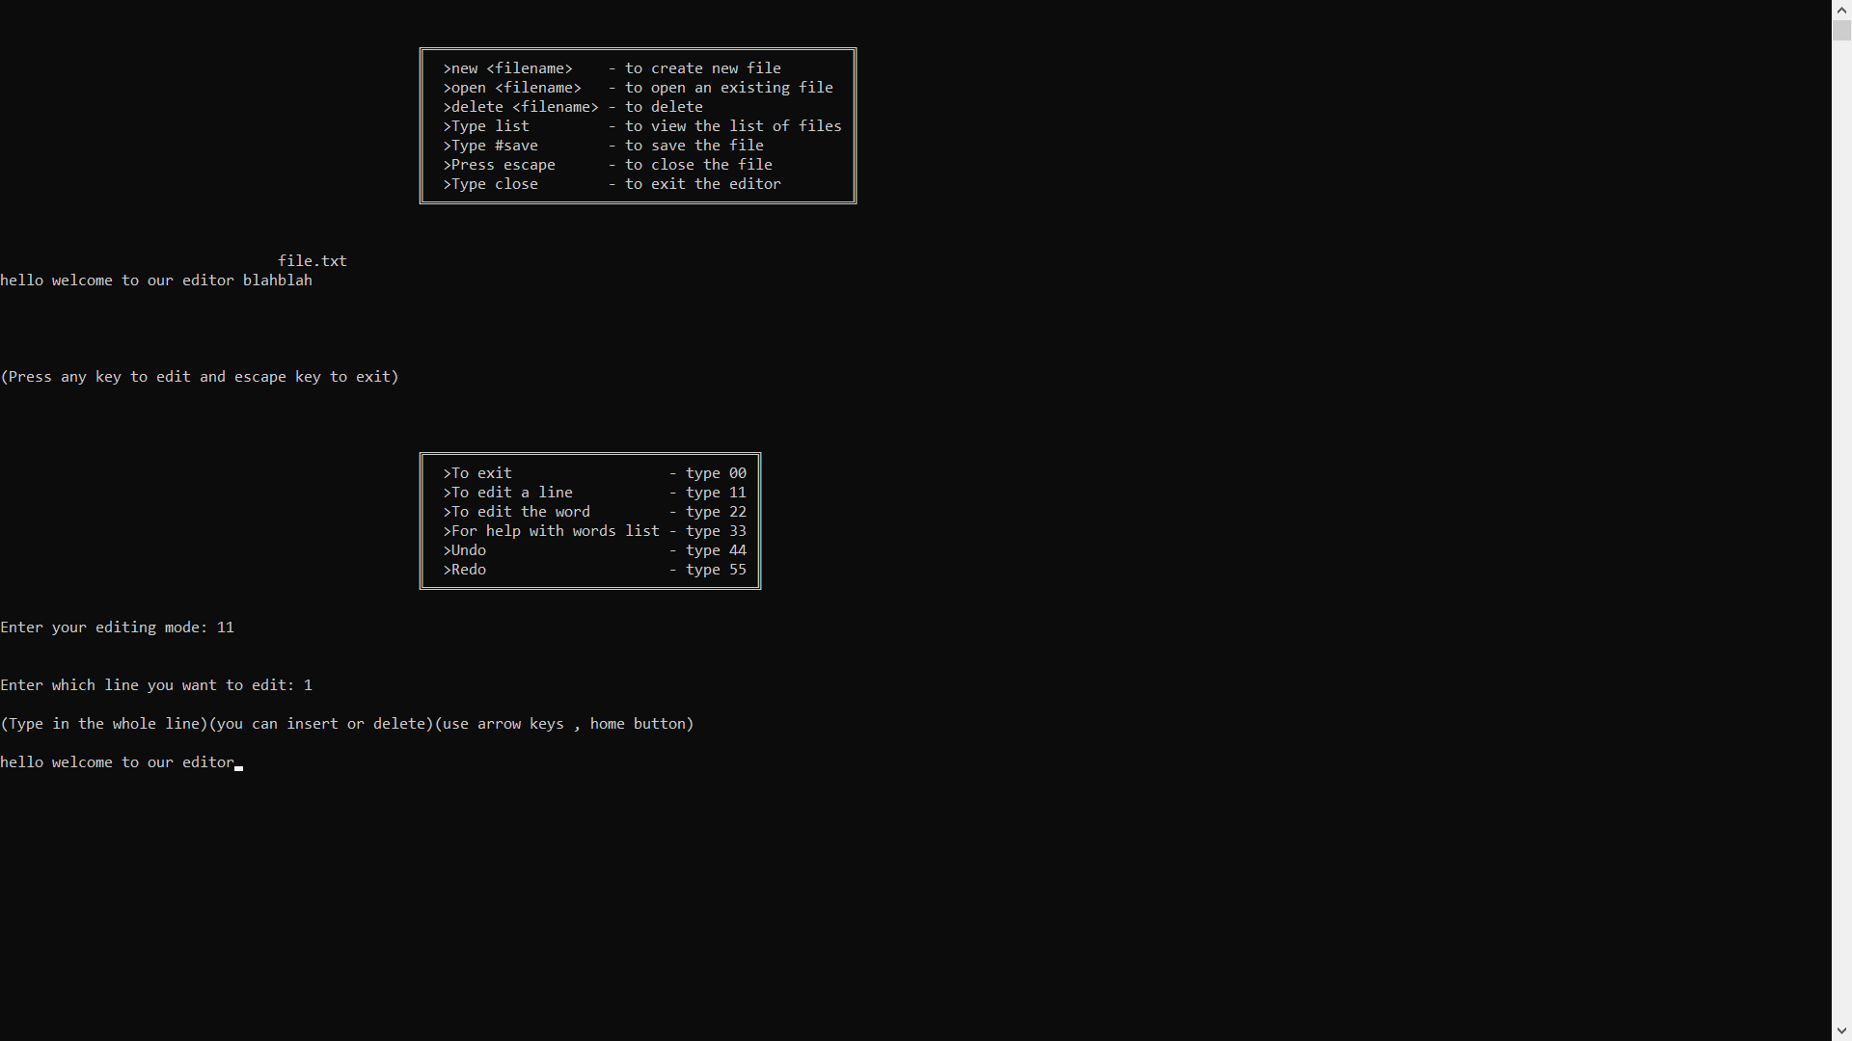
Editing a given line (11) the line will be rewritten in the file

Slide 23
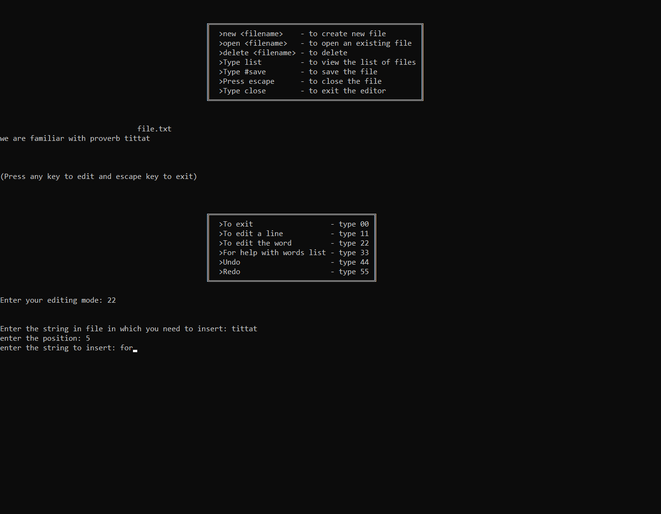
Now i have opened a file to edit word (22)
Explanation
Usage of Gap buffer
And linked list
When we type editing mode 22
We can edit the words
Step 1:Type the file word to edit
Step 2:Type the position to insert
Step 3:Type insertion word and
Press enter the word will be inserted and file will be rewritten

Slide 24
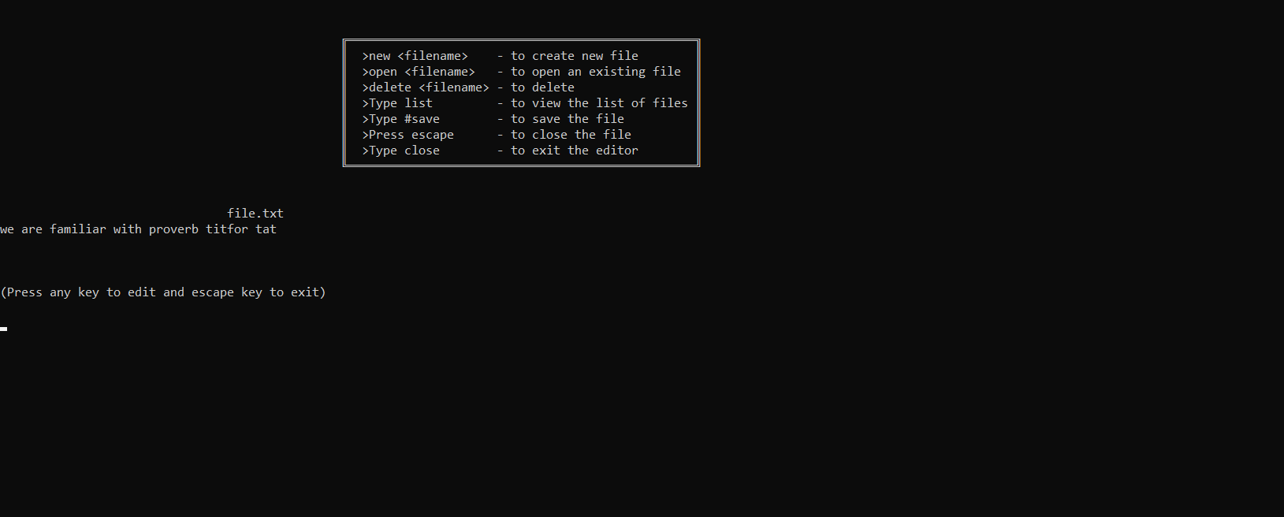
Result of gap buffer
The words are first fetched from file using doubly linked list and the node is searched and the word is changed using gap buffer any change we make in file is actually we are changing them using linked list node

Slide 25
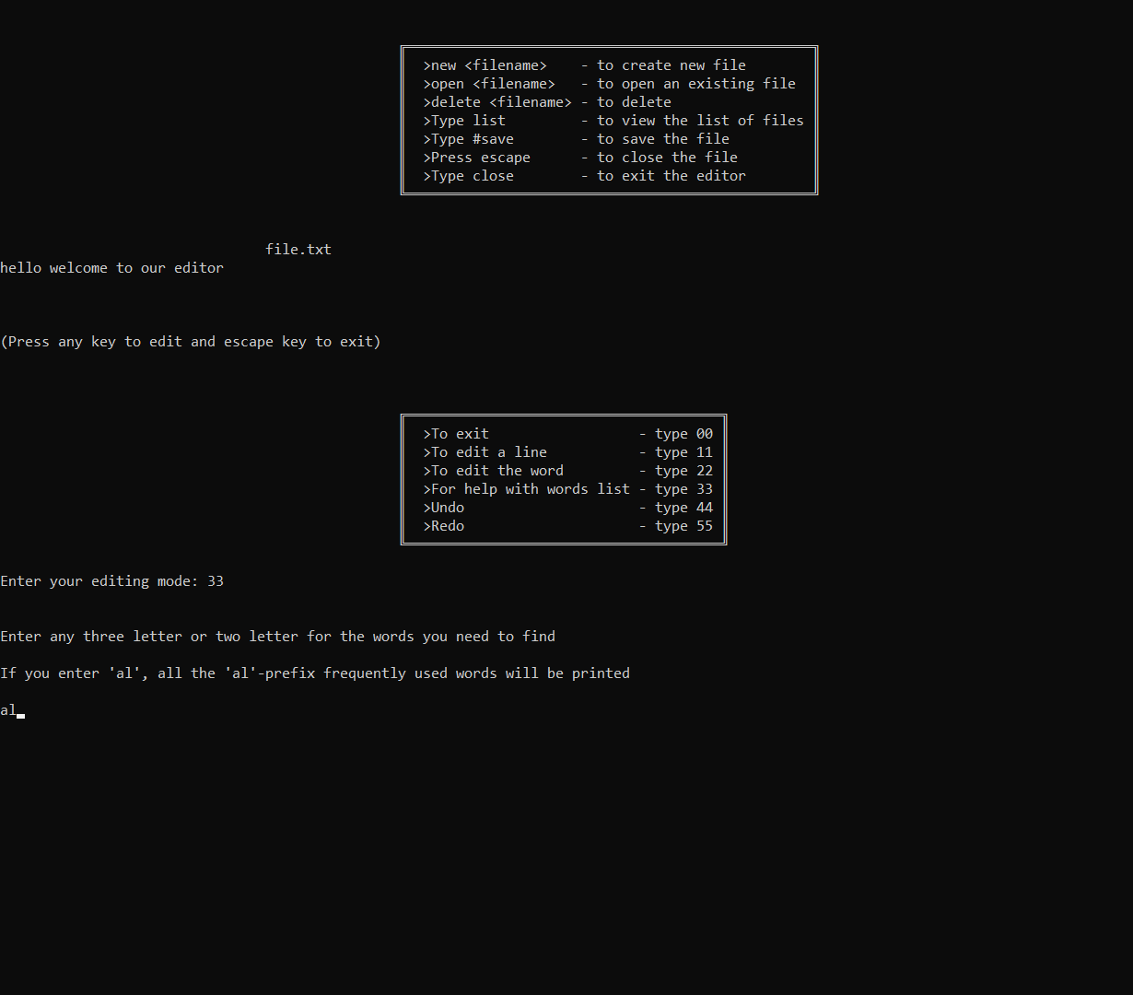
prefix words display using mode (33)
Explanation
Usage of Trie
When i type particular prefix example say al.All the words with the prefix.That are inserted in the trie will be displayed we actually inserted 20000 frequently used words.we can actually use it in autocomplete feature in words in normal editor window it is not possible to move upward after displaying the text so we used to print prefix words

Slide 26
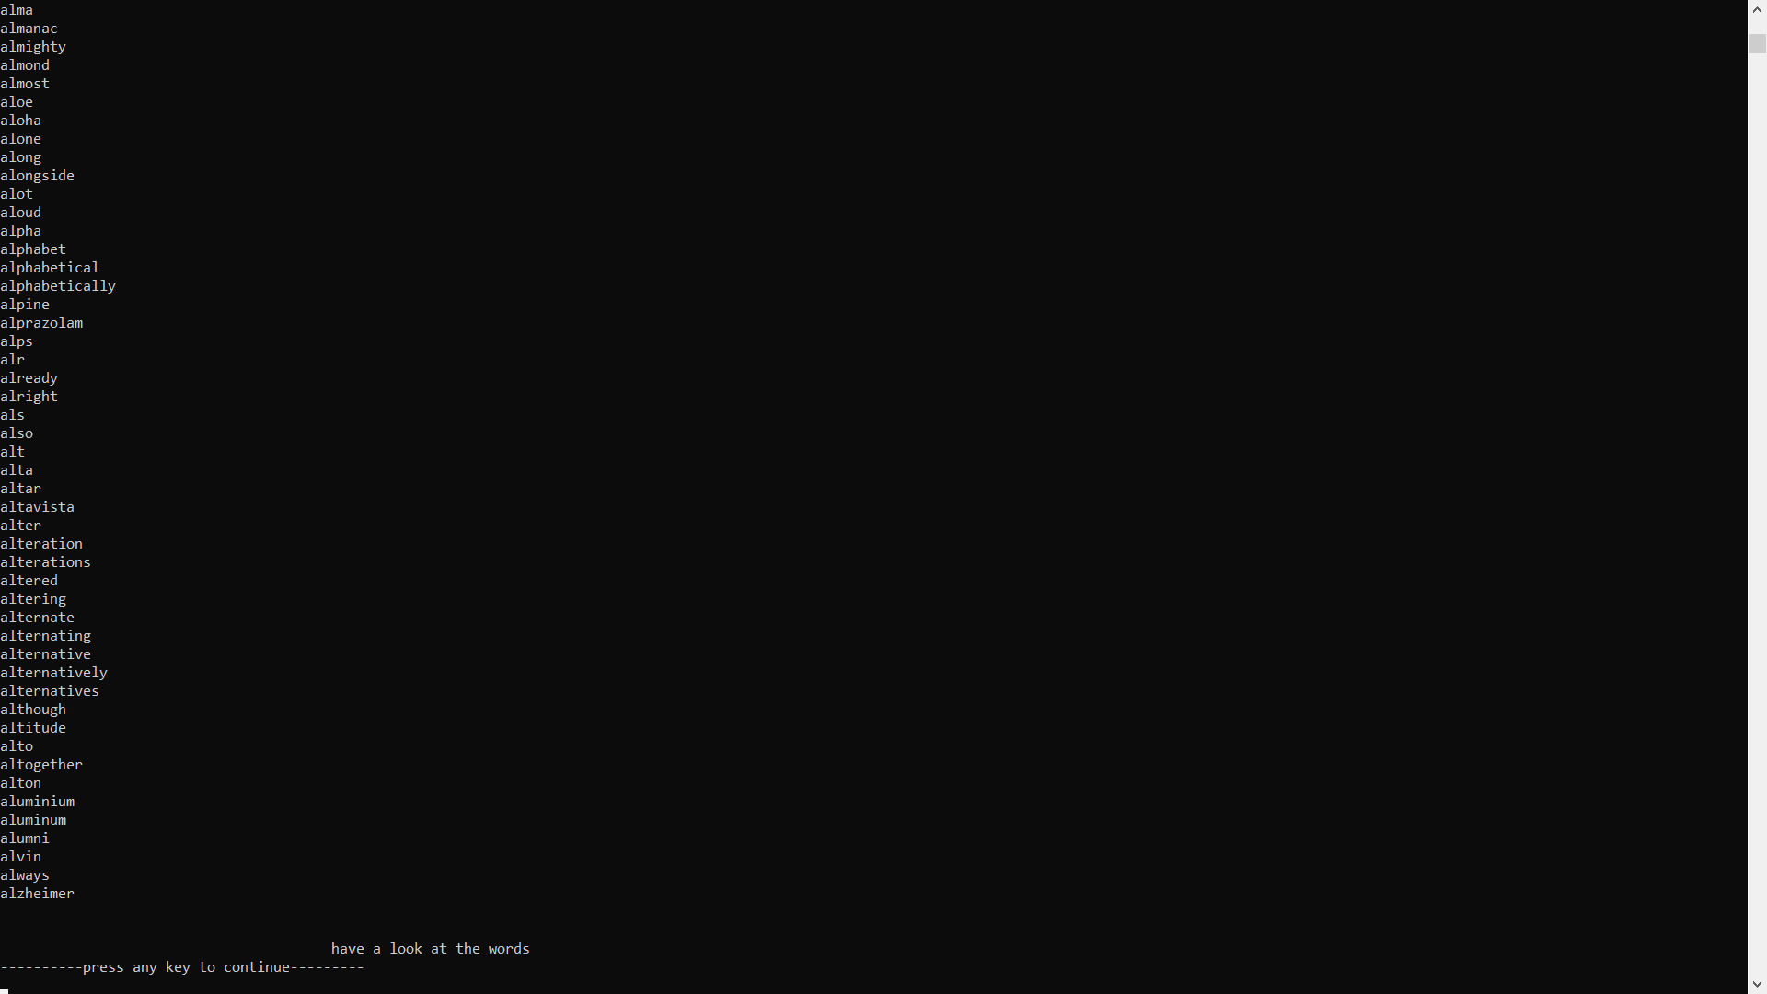
Result of displaying 150 al- prefix words

Slide 27
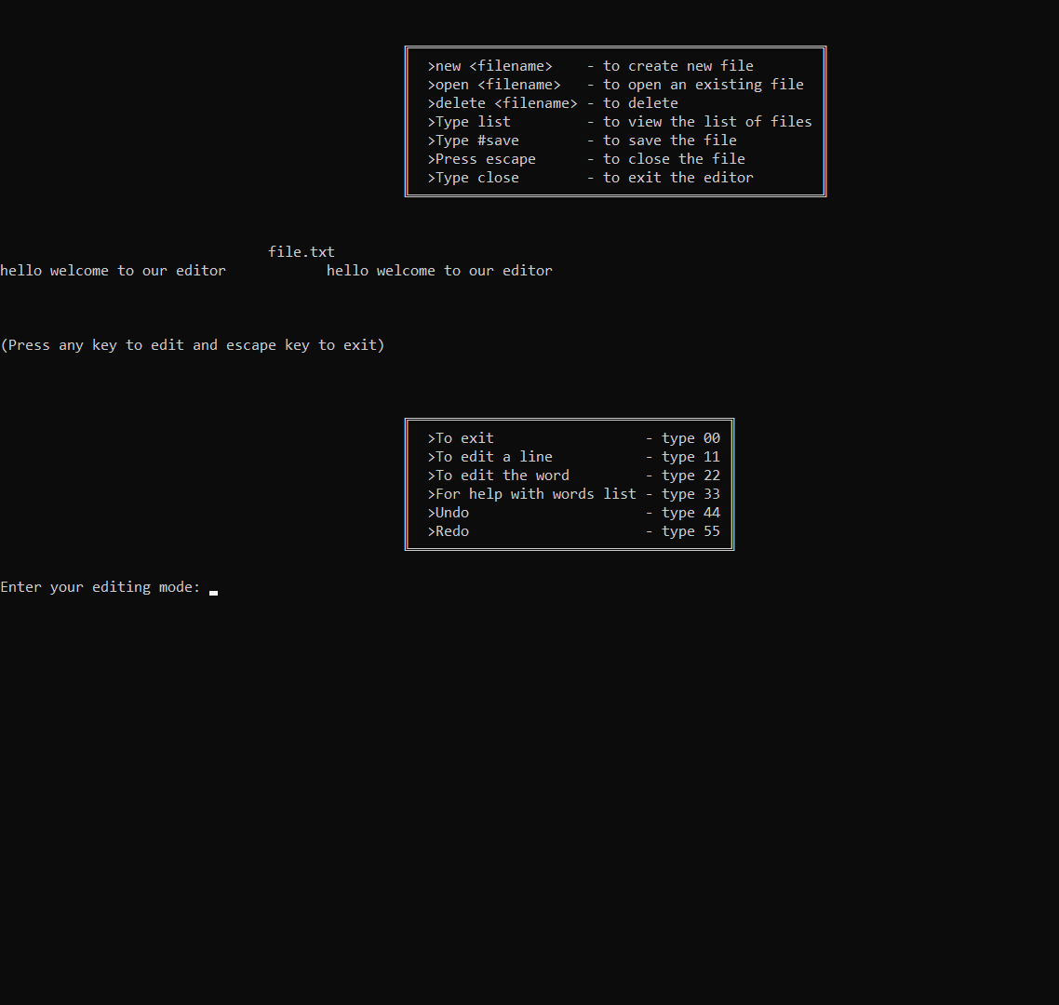
Undo redo using stack
Explanation
Usage of Stack
Consider that i have modified my file using 11 edit line now to undo if i type 44 in editing mode
Changes made will be discarded
If i type 55 in editing mode after undo it will redo and display the screen

Slide 28

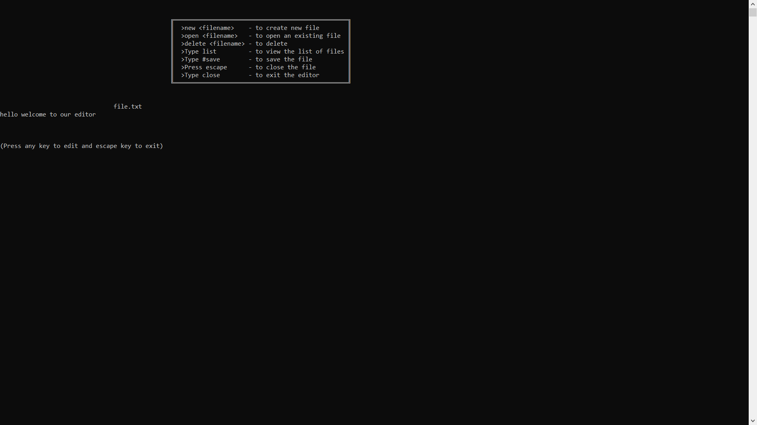
Result of Undo
It will be undoed
And saved in the file

Slide 29
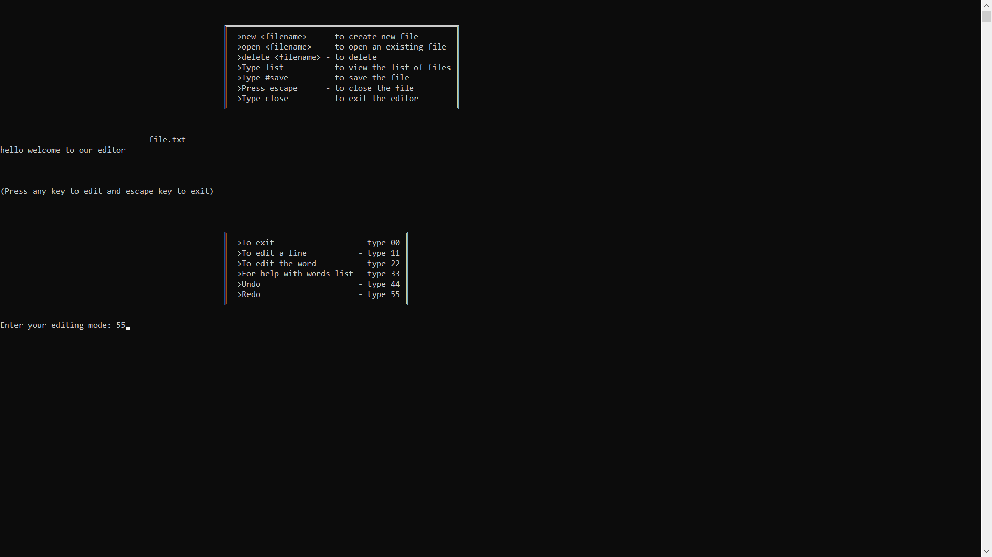
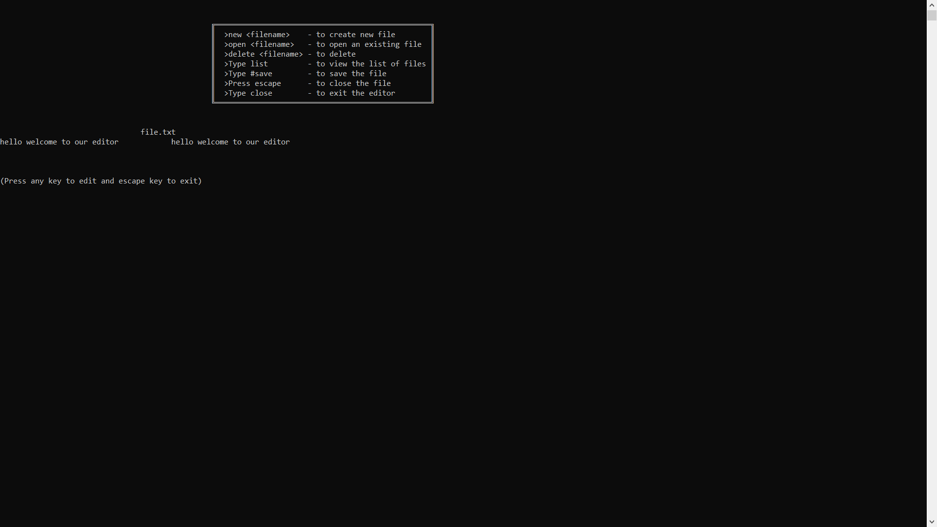
Result of Redo
The undo made is now
Redone using redo
And saved in the file

Slide 30
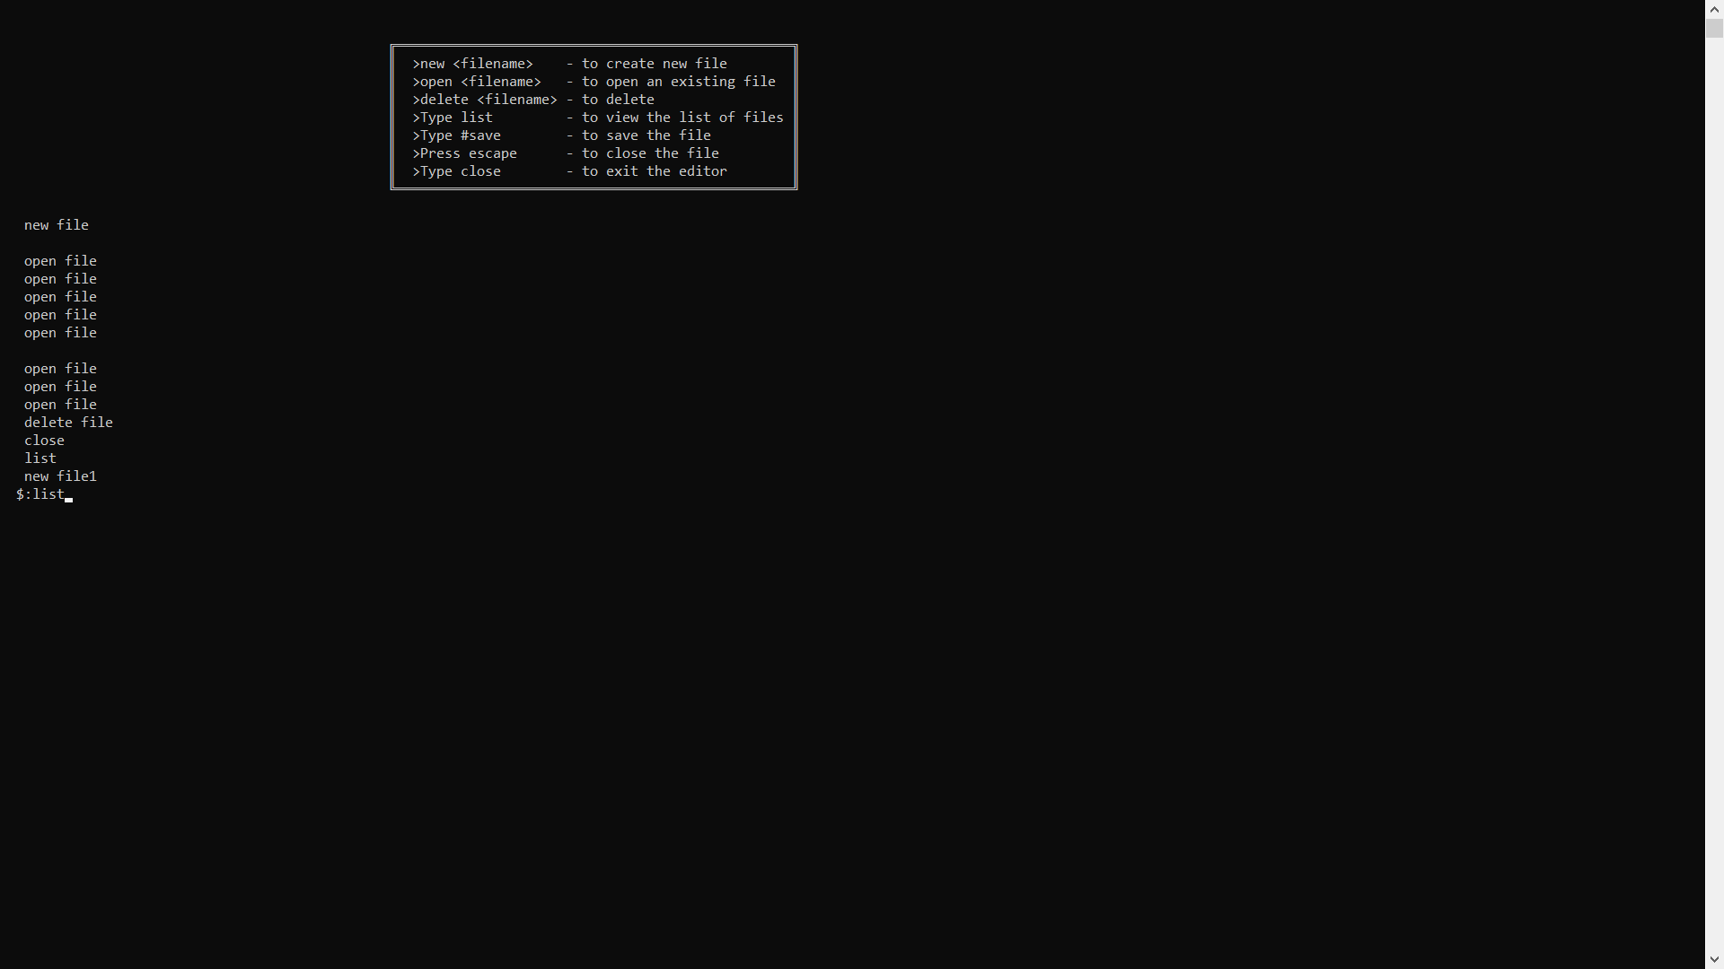

List of files and commands
List of commands is displayed above the dollar .Then when we type list list of files created is displayed

Slide 31


